Slide 1

Analysis of SQuAD Dataset
Presented By
Muwahid Munshi
12306969

Slide 2

Understanding Question Answering Challenges
The SQuAD dataset presents a significant challenge in natural language processing by requiring models to accurately answer questions based on given contexts.
Unanswerable questions add complexity, demanding models to identify when no answer exists.

Slide 3
SQuAD Dataset Characteristics
Source: Wikipedia articles
01
Content: Question-answer pairs
02
Versions: SQuAD 1.1 and SQuAD 2.0
03
SQuAD 2.0 Features: Includes unanswerable questions
04

Slide 4
Methodology for Analysis
Data Preparation: Loading and preprocessing the dataset
Exploratory Data Analysis: Understanding question types and answer distributions
Clustering Analysis: Grouping similar questions
Visualization: Using plots to illustrate findings

Slide 5

Insights from Exploratory Data Analysis
Question Types: Distribution of question categories
Answer Lengths: Analysis of answer lengths and their implications
Context Lengths: Impact of context size on question complexity

Slide 6
Clustering Similar Questions
Method: t-SNE for dimensionality reduction
Findings: Visualization of clusters and their characteristics
Implications: Insights into question similarity and difficulty

Slide 7
Attribute Details Post Dimension Reduction
Title
Context
Question
Answer
Is_impossible
Answer_categories
Difficulty
Cluster
X
Y

Slide 8
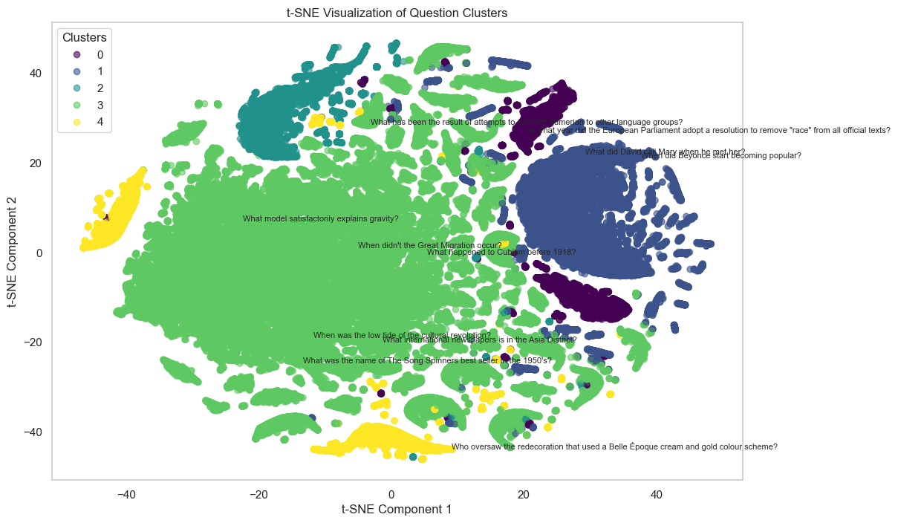
Visualizing Clusters and Difficulty

Slide 9

Approach to Predicting Unanswerable Questions
Model Selection: Choosing a suitable pre-trained model
Fine-Tuning: Adjusting the model for unanswerable questions
Evaluation Metrics: Assessing model performance

Slide 10
Change Log
Data Processing
Usage of json library to efficiently process the dataset without loosing its characteristics
Change in Visualizations for better representations with details
Trouble-shooting training by configuring resources:
CPU & GPU
CPU
Testing scores based on different models, and hardware resource utilization during training on the split dataset
Better clustering by the help of sampling from the primary data set

Slide 11
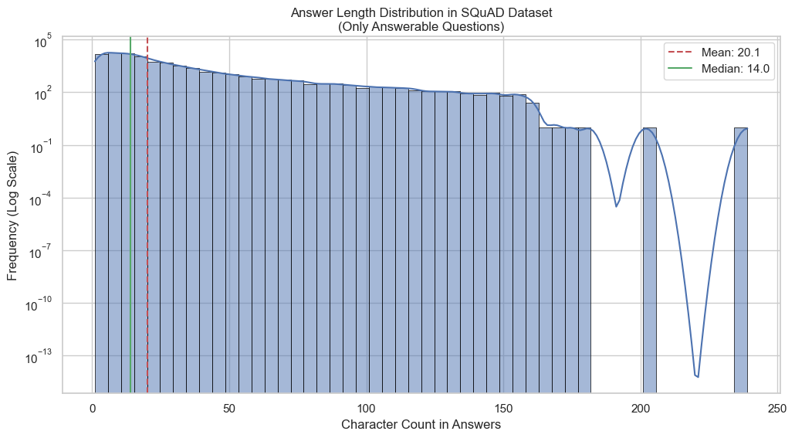
Answer Length Distribution and stats.

Slide 12
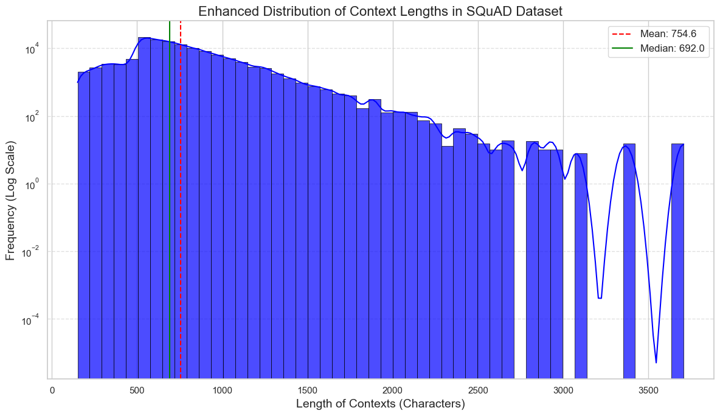
Enhanced Distribution of Context Lengths

Slide 13
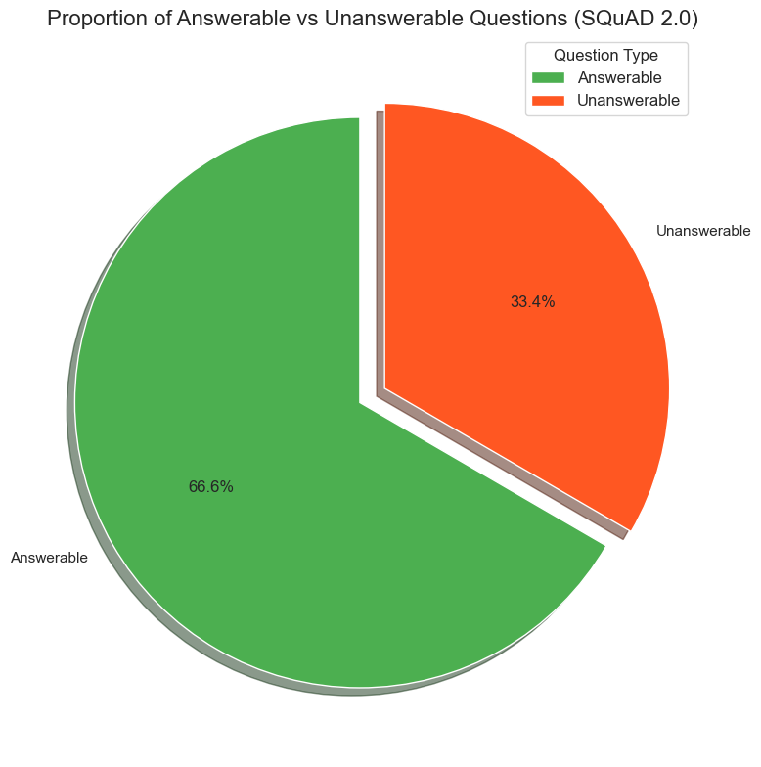
Proportion of Answerable vs Unanswerable Questions

Slide 14
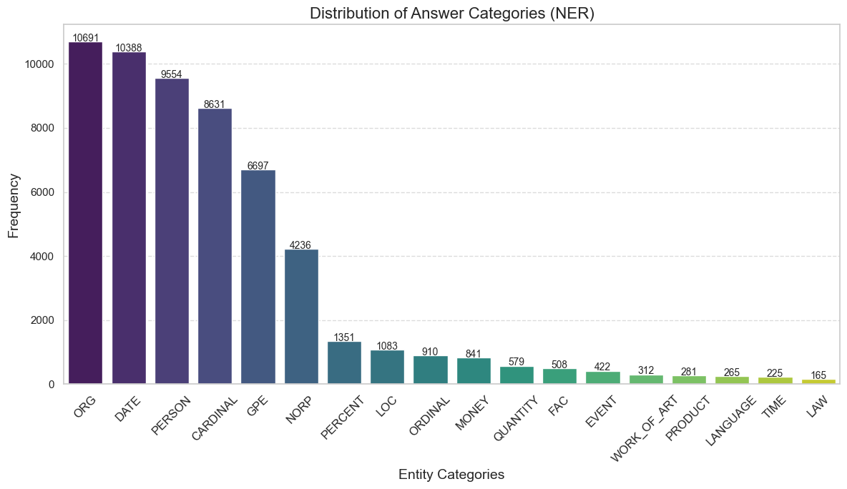
Distribution of Answer Categories

Slide 15
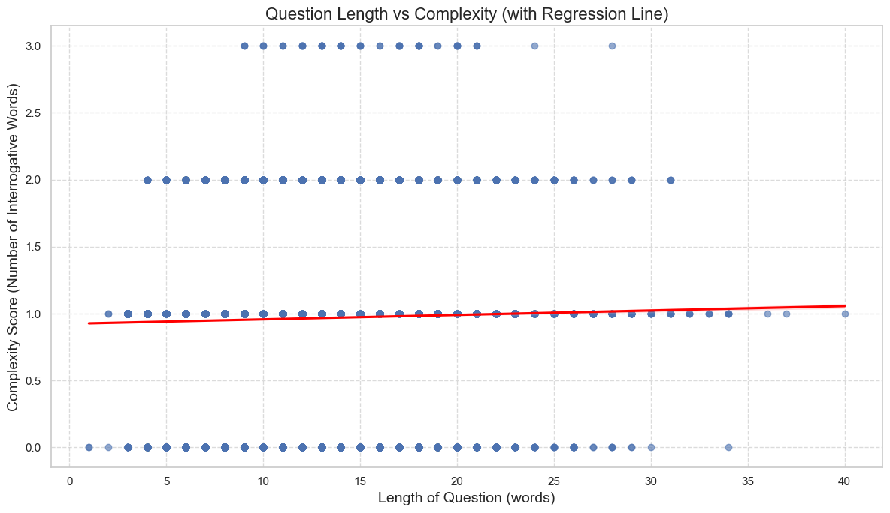
Analyzing Difficulty with Regression Line

Slide 16
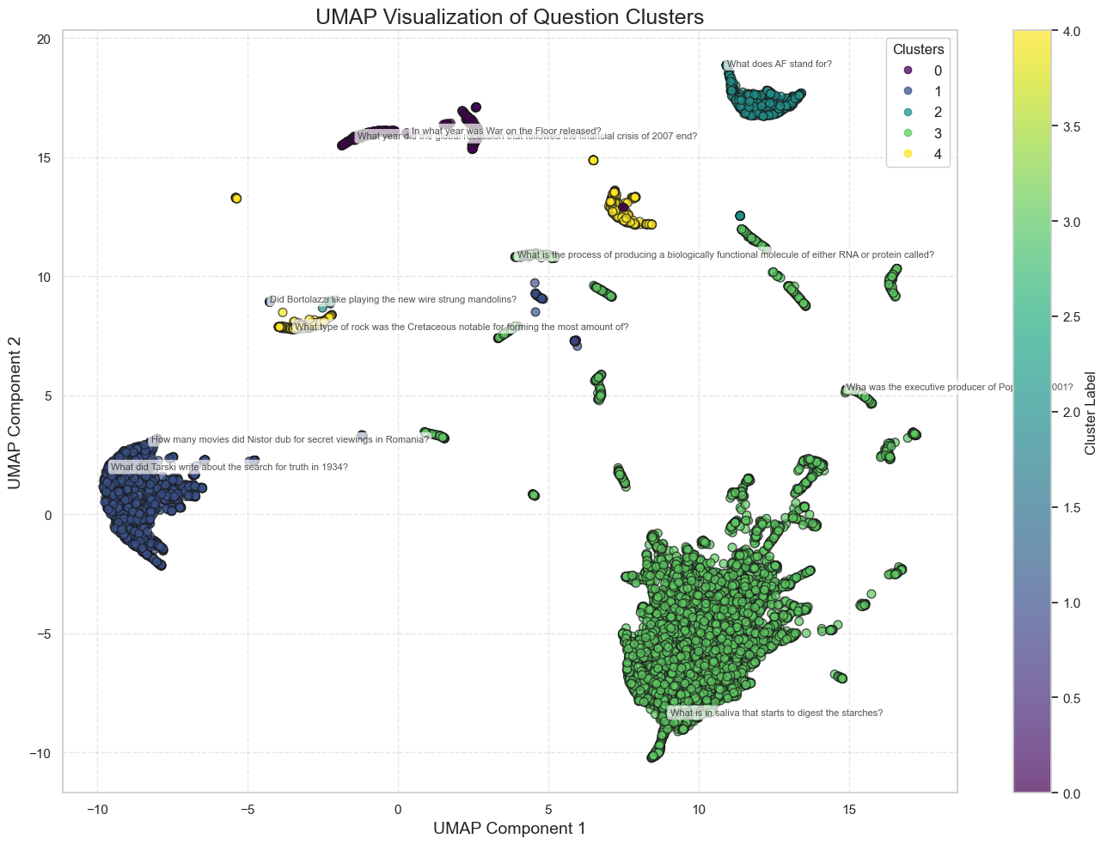
Dimension Reduction using TruncatedSVD and UMAP and Enhanced Clustering on the sample pulled from the OG dataset

Slide 17
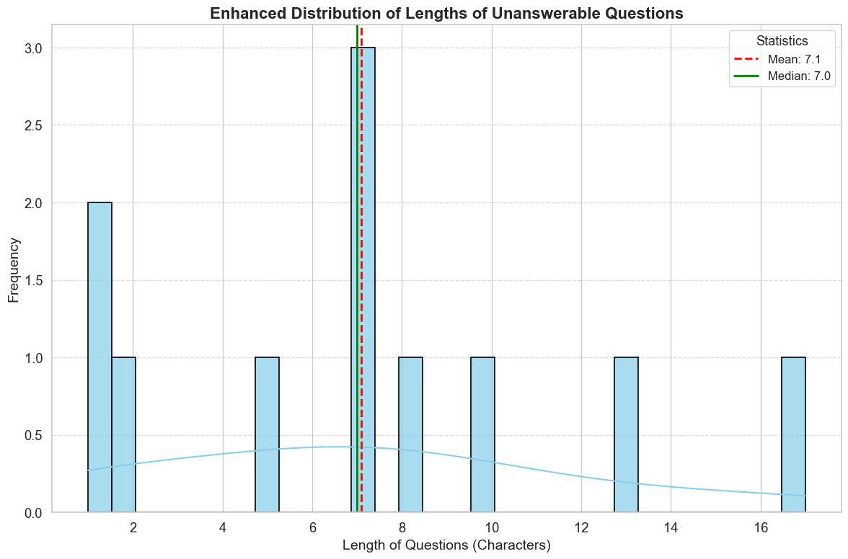
Distribution of Lengths of Unanswerable Questions

Slide 18
Precision Check
1st Case: 2.15%
2nd Case: 16.68%
3rd Case: 9.15%
4th Case: 11.80%
5th Case: 10.60%
Best Case: TBA (ETA: 33 hrs. approx.)
Current phase on model training that requires time and other workarounds

